Slide 1
JavaSсript: ES6
Zvorskyi Ivan
Ivan.zvorskyi@softengi.com

Slide 2
Содержание
Что такое ECMAScript6
Block Scoping
Destructuring
Новые методы
Template string
Arrow functions
Classes
Modules

Slide 3
Что такое ECMAScript
Это Стандарт
Ecma, TC39
Mozilla, Yahoo, Microsoft, Google, Intel & jQuery
(Adobe, Opera, Dojo & others)

Slide 4

TC-39

Slide 5
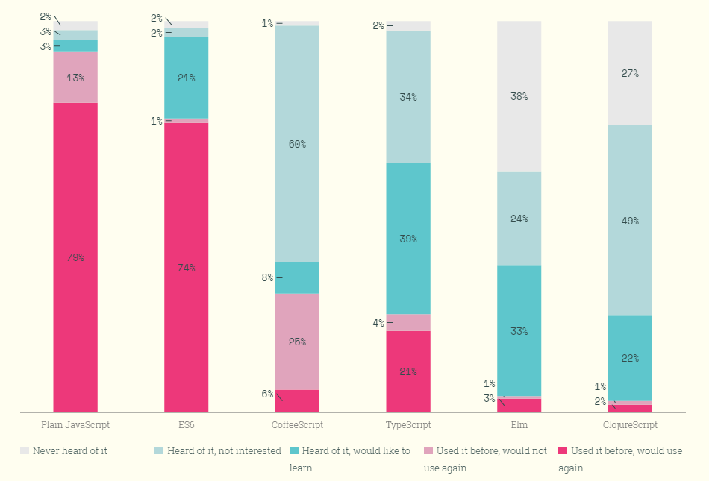

Slide 6
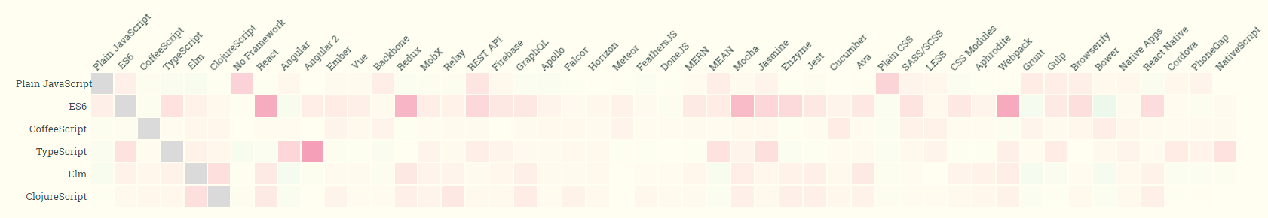

Slide 7
Important terms: TC39 (Ecma Technical Committee 39): the committee evolving JavaScript. Members: companies (all major browser vendors etc.). Meetings attended by employees and invited experts. JavaScript: colloquially: the language; formally: one implementation ECMAScript: the language standard ECMAScript Harmony: improvements after ECMAScript 5 (ECMAScript 6 and 7) ECMAScript.next: code name for upcoming version, subset of Harmony ECMAScript 6: the final name of ECMAScript.next (probably)

Slide 8
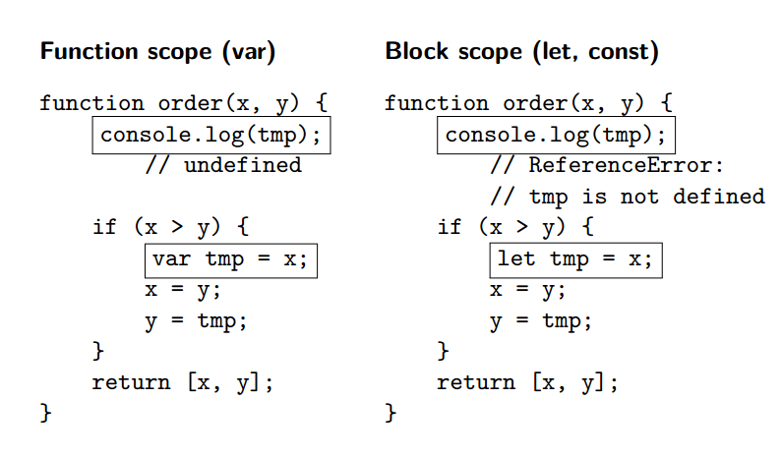

Slide 9
Object.assign();
Object.keys();

Slide 10
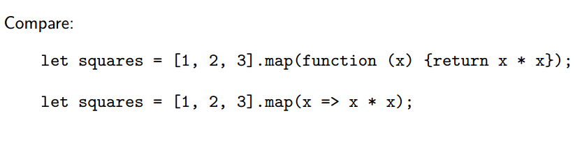
Arrow functions
Arrow functions: lexical this, no more that=this

Slide 11
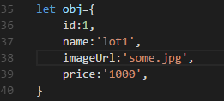
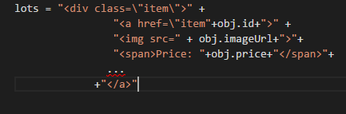

Template String

Slide 12

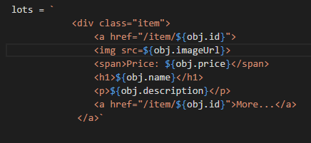
Template String

Slide 13


Slide 14
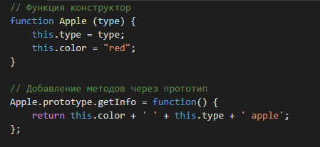
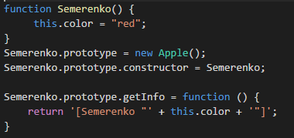
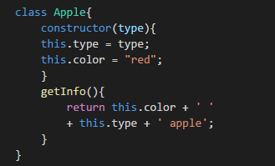
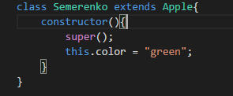
Classes(syntaxis sugar)
https://www.sitepoint.com/object-oriented-javascript-deep-dive-es6-classes/

Slide 15
Modules

Slide 16
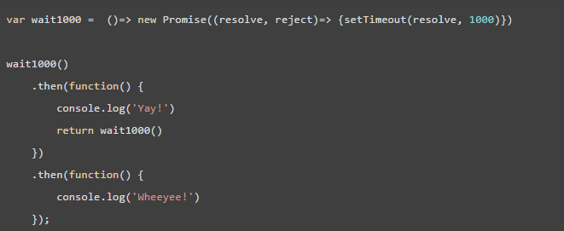

Slide 17
Упущено
New Math, Number, String, Array and Object methods
Binary and octal number types
Default rest spread
For of comprehensions (hello again mighty CoffeeScript!)
Symbols
Tail calls
Generators
New data structures like Map and Set

Slide 18

Thank you! Relax time

